Slide 1
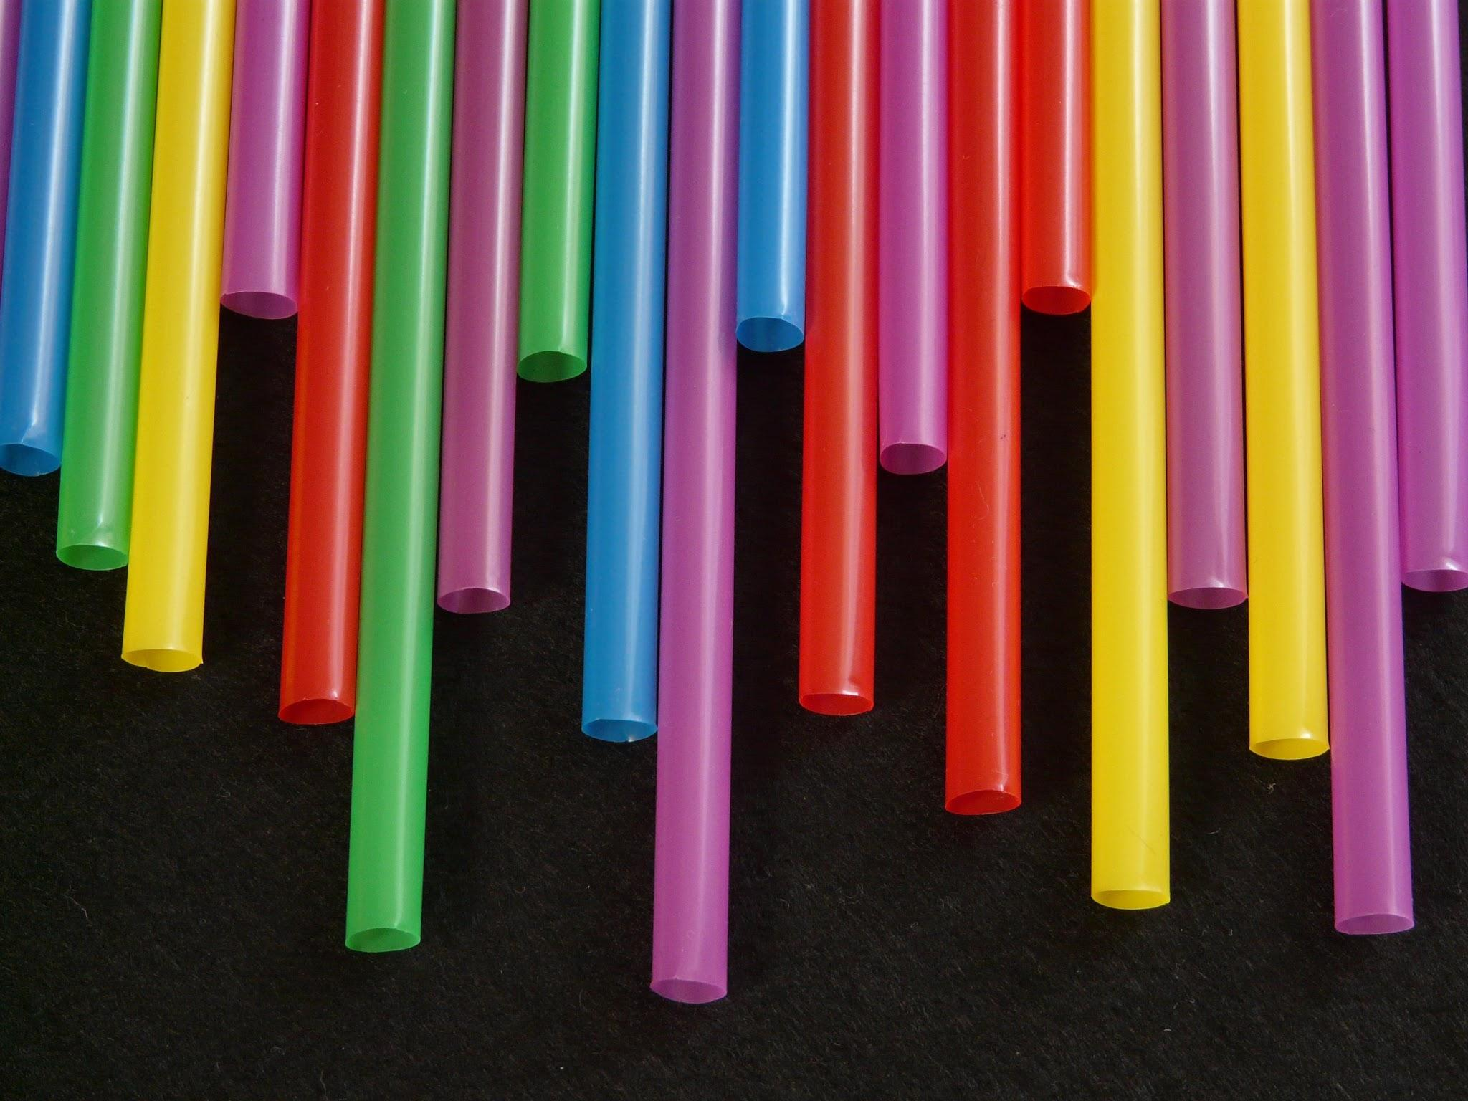
STRAWS
WHY is it A PROBLEM

Slide 2
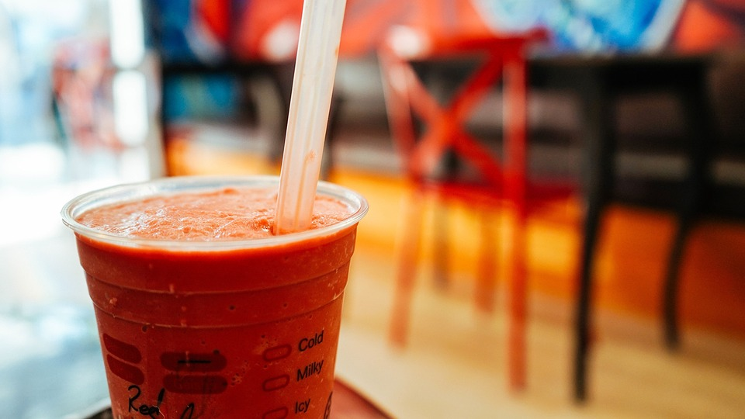
Skip a straw save a life
Americans alone use 500,000,000 straws a day. And most of them end up in the ocean and they don't dissolve! Evinchily they are tiny little pieces that fish mistaken for plankton so they eat it! And it mite kill it

Slide 3
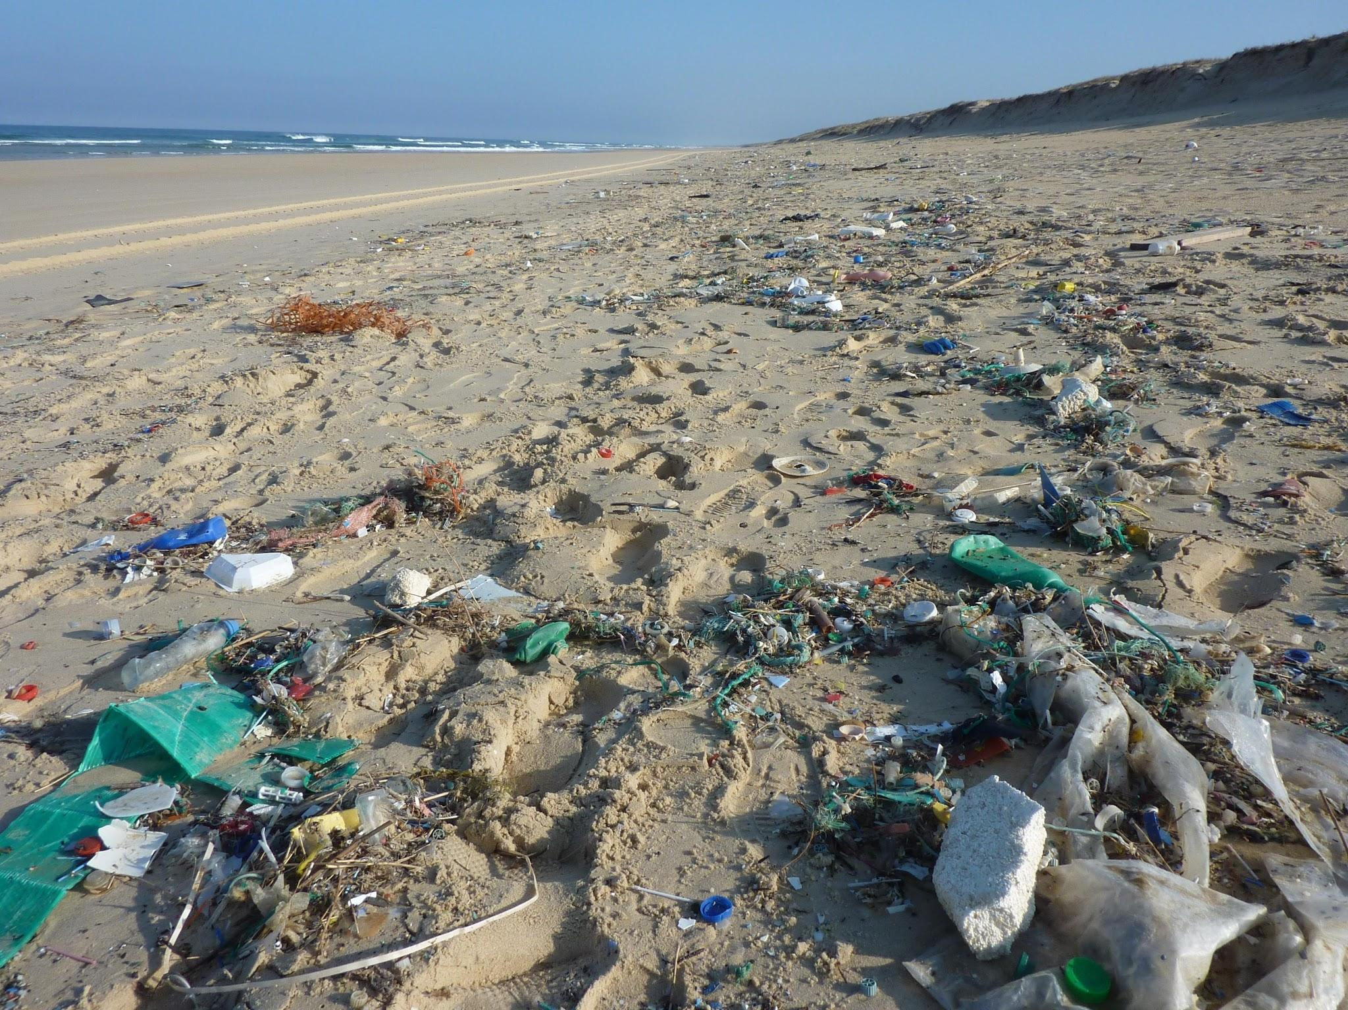
Look at all that trash
Out of all this trash I see a lot of straws. If everyone used less straws there would be less to clean up, And less dead fish.

Slide 4
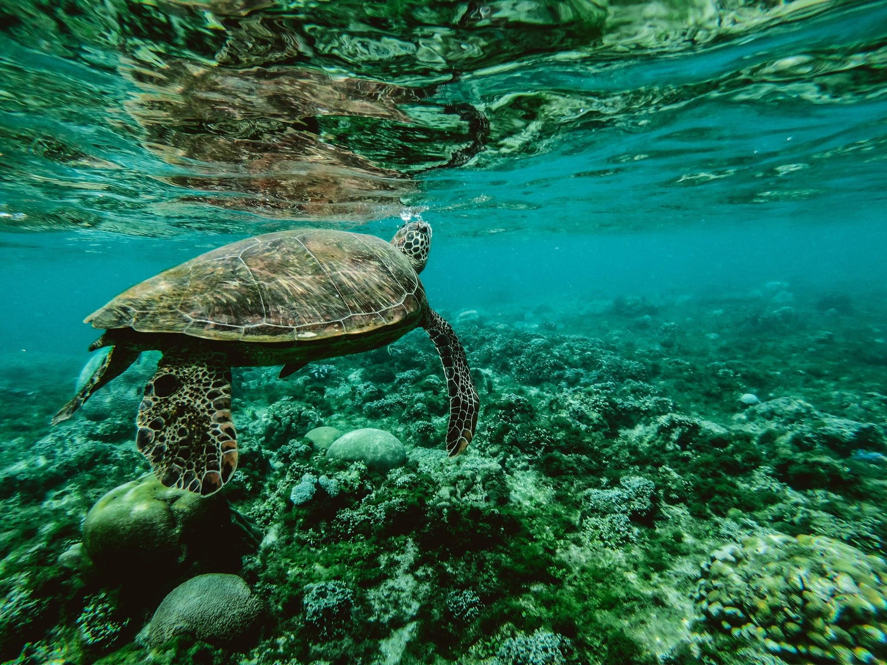
Animals
250,000 tons of straws are in the sea, and by 2050 there will be more straws than fish!

Slide 5

Save the sea!
To stop all this or alest help, next time you go to a restaurant ask for no straw.

