Slide 1
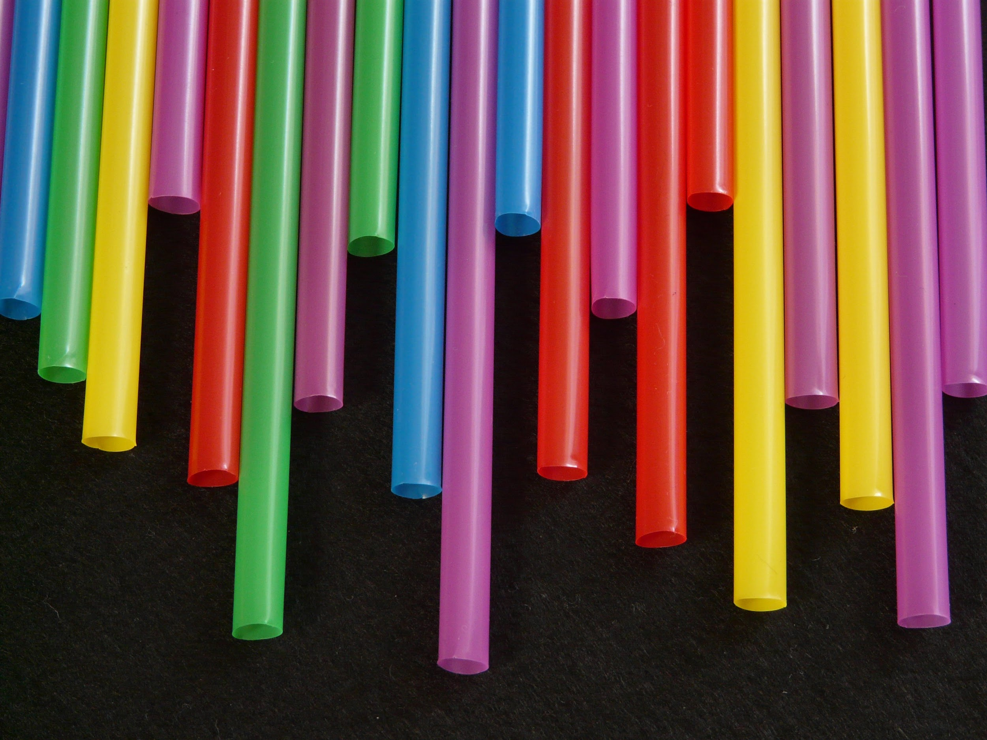
SAY NO TO PLASTIC STRAWS
By: Joshua, Drew, Judaya, Krish, Will

Slide 2
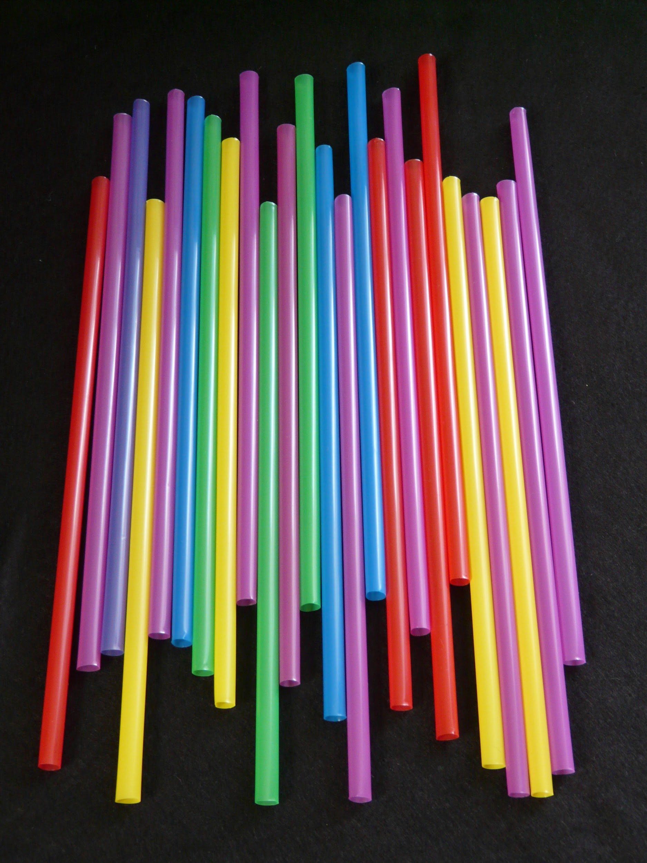
500 million Plastic straws are used every day in the U.S
And that’s only a fraction of the ones used in the entire world!

Slide 3
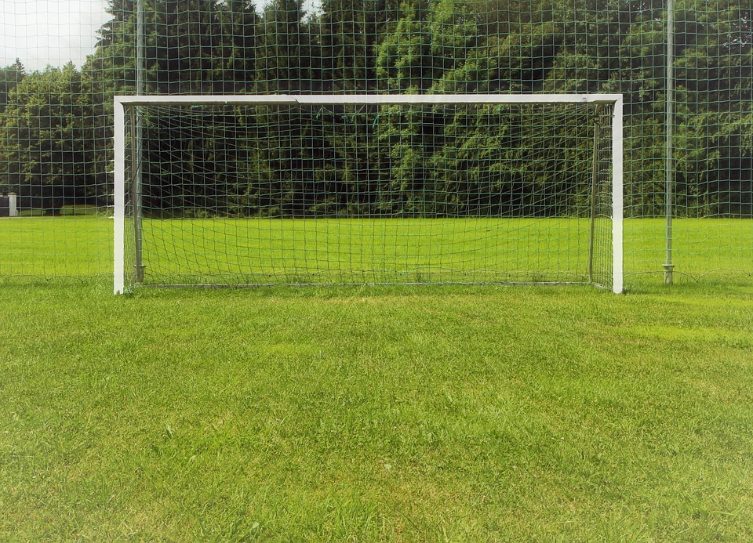
Goal
Our goal is to have plastic straws banned and to make our oceans clear of all plastic so that our marine life can eat whatever is in their ocean without the risk of the food or object being poisoned with plastic. Plastic straws are also really bad for our health. So stop using straws!

Slide 4

How Does This Affect Us?
Well obviously there will be less seafood for us but the plastic can hurt us because it can get into our bodies.
First we dump the plastic in to the sea, Second a small fish eats it because it gets inside of its normal food, Third a medium sized fish eats the small fish, Fourth a huge fish eats the medium sized fish and then one of our fishermen goes fishing and catches that huge fish and they sell it to a grocery store or restaurant and then we eat the huge fish with the plastic still inside.

Slide 5
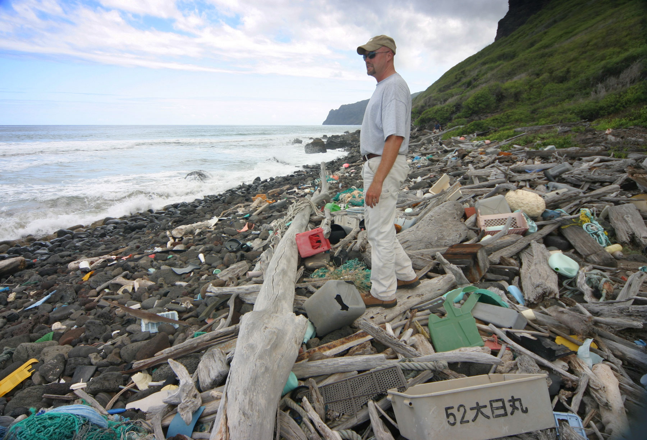
5 Trillion
Pieces of garbage are floating in the ocean right now.

Slide 6
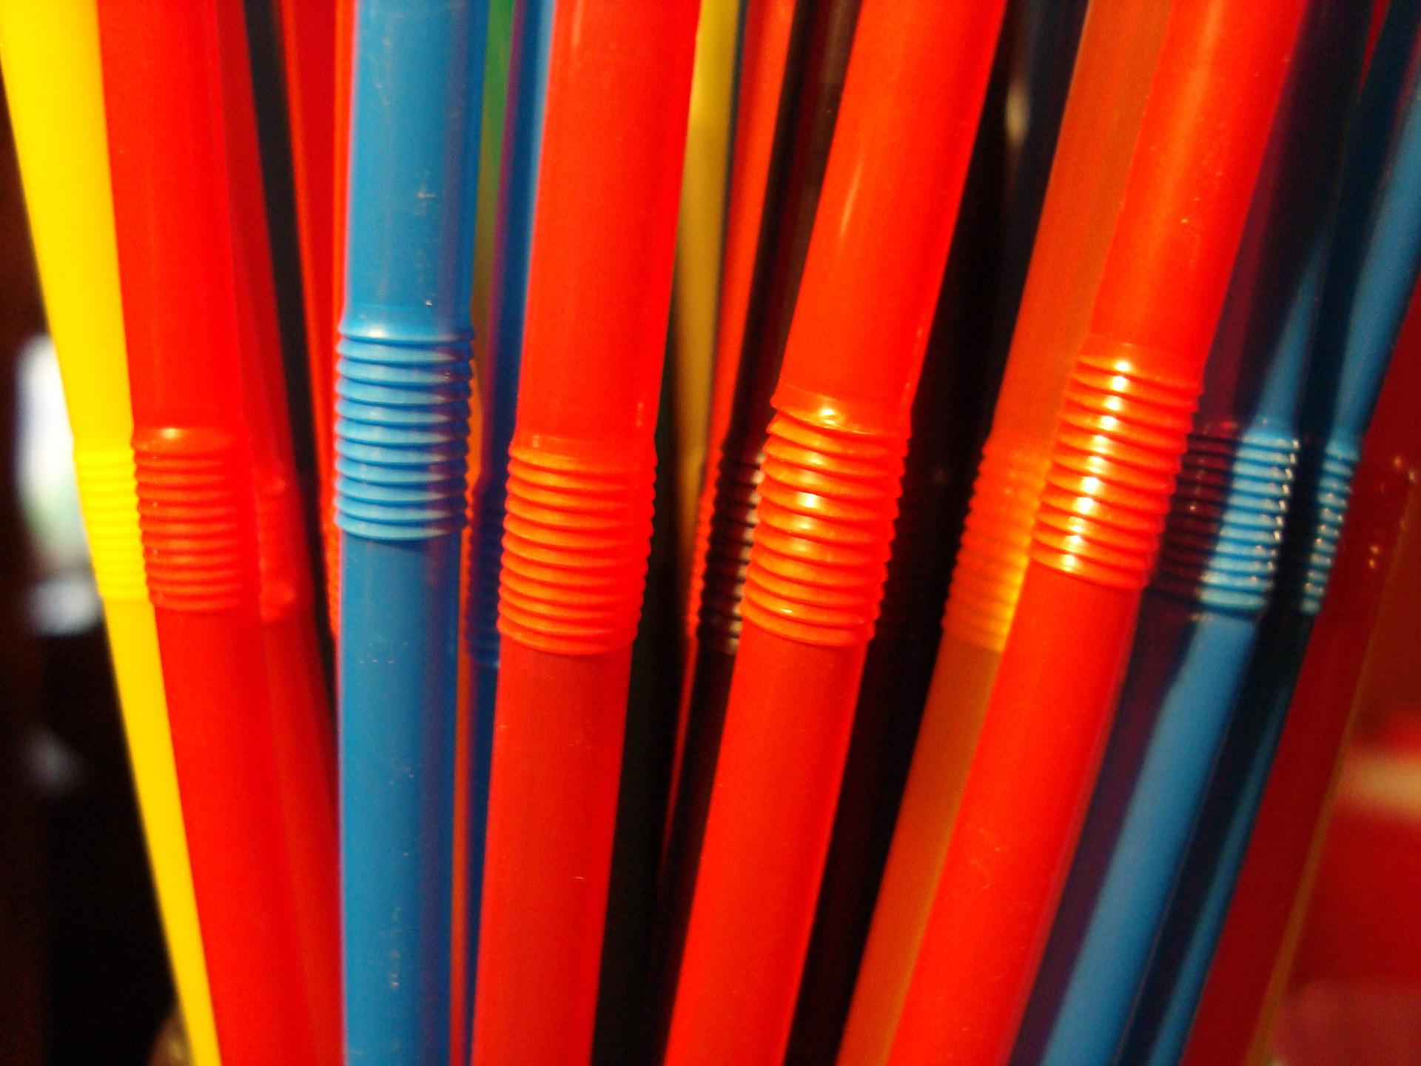
On average, 1 straw is only used for 20 minutes
If you have 1 every meal, that’s at least 3 straws a day!
Notes:
UGI

Slide 7
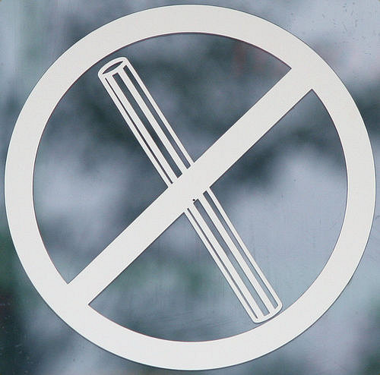

Where straws have been banned
The United Kingdom is in the process of banning them.
The European Union is also in the process.
In Malibu, California, plastic straws are illegal.

Slide 8
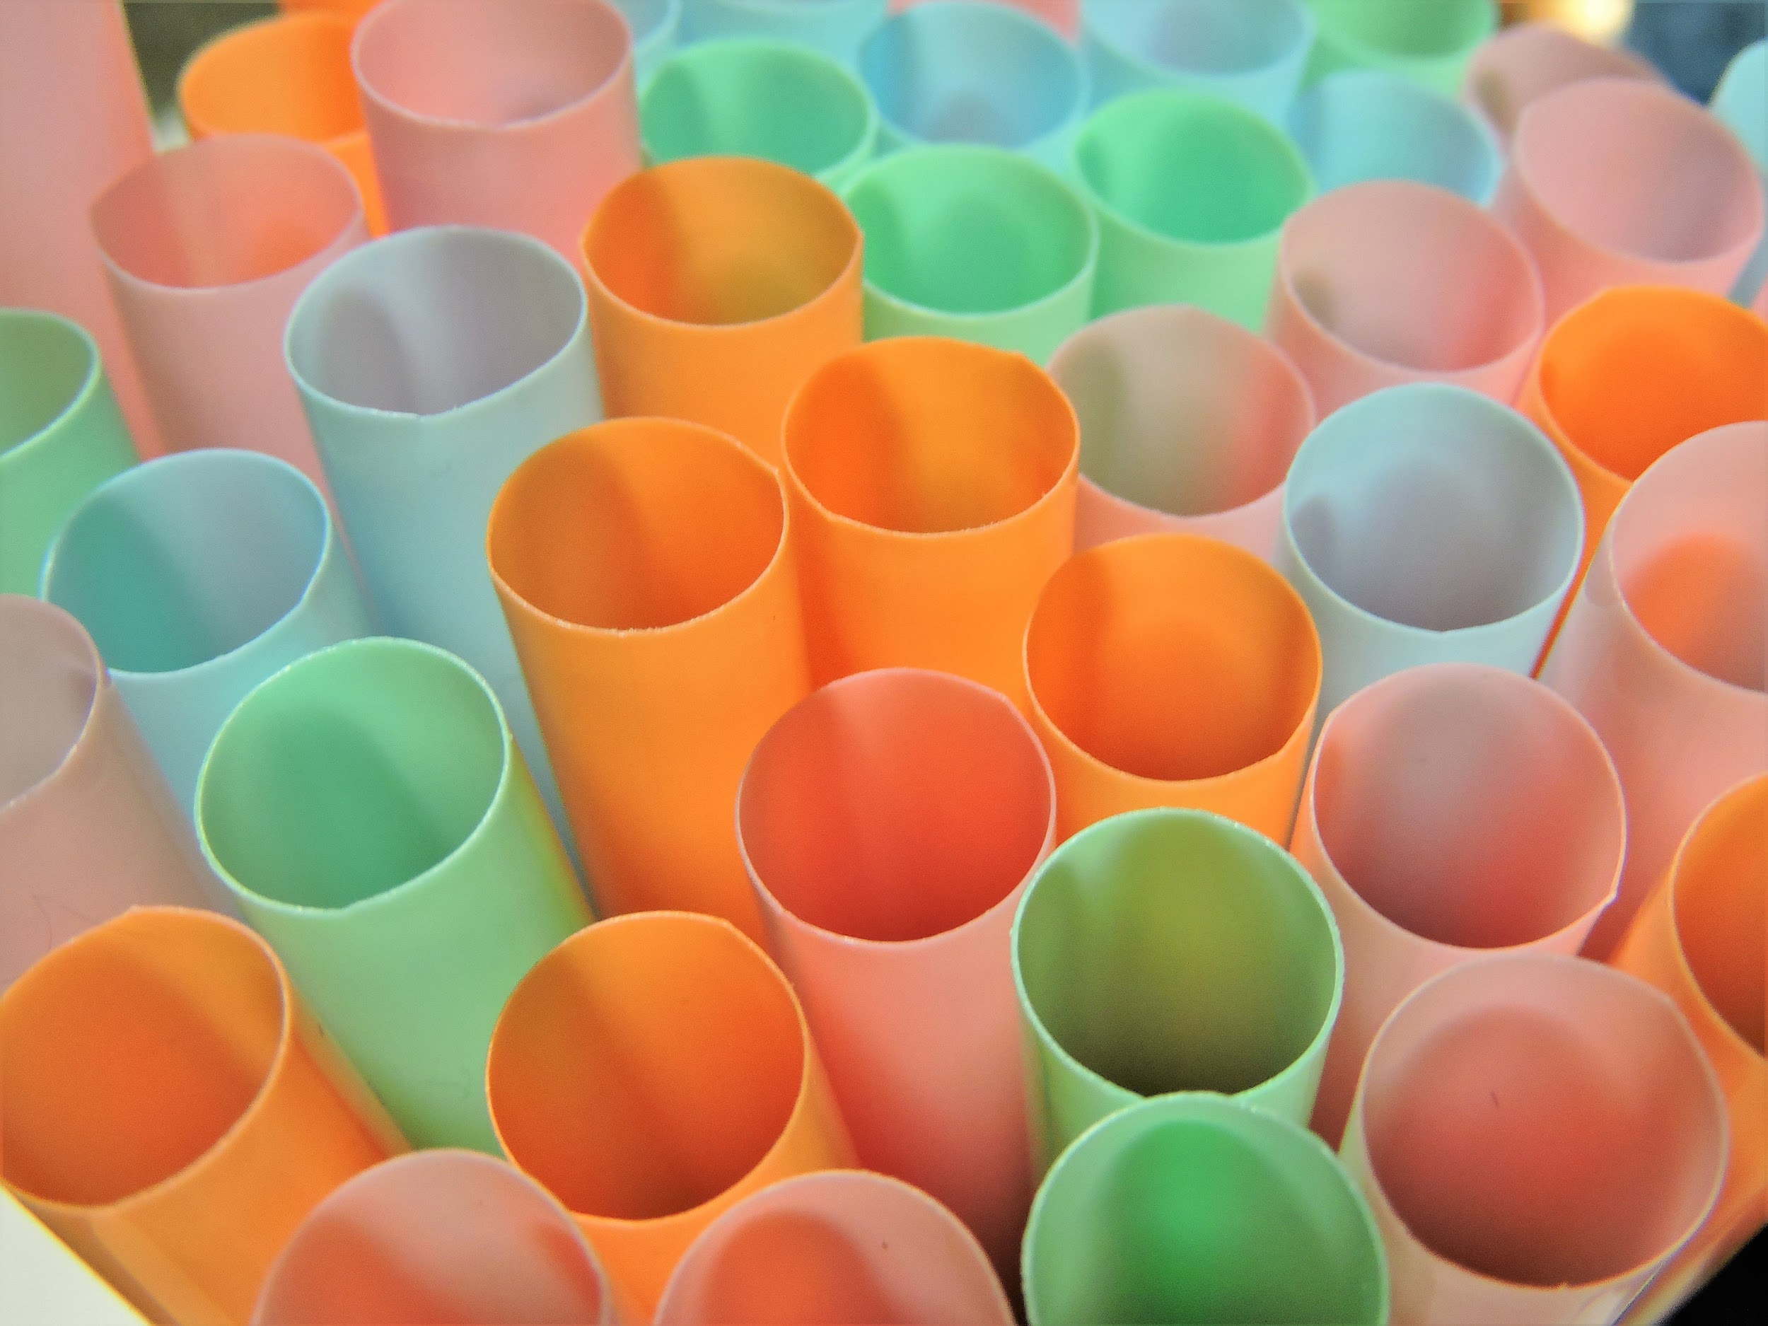
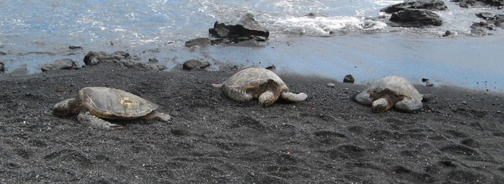
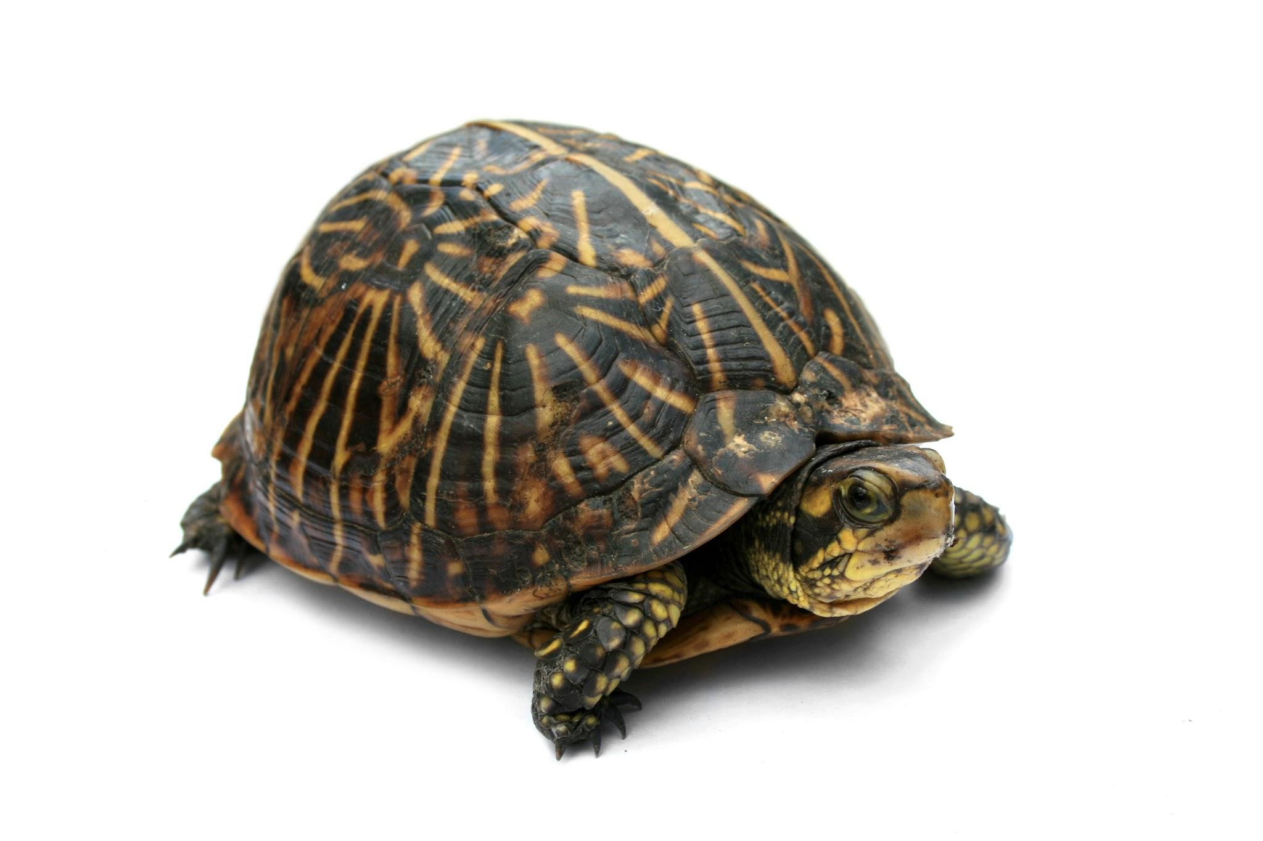
At least 100,000 aquatic animals die annually because of plastic trash.
Plastic can be recycled in the USA, so we
need to consider what our actions do, and not litter.

Slide 9
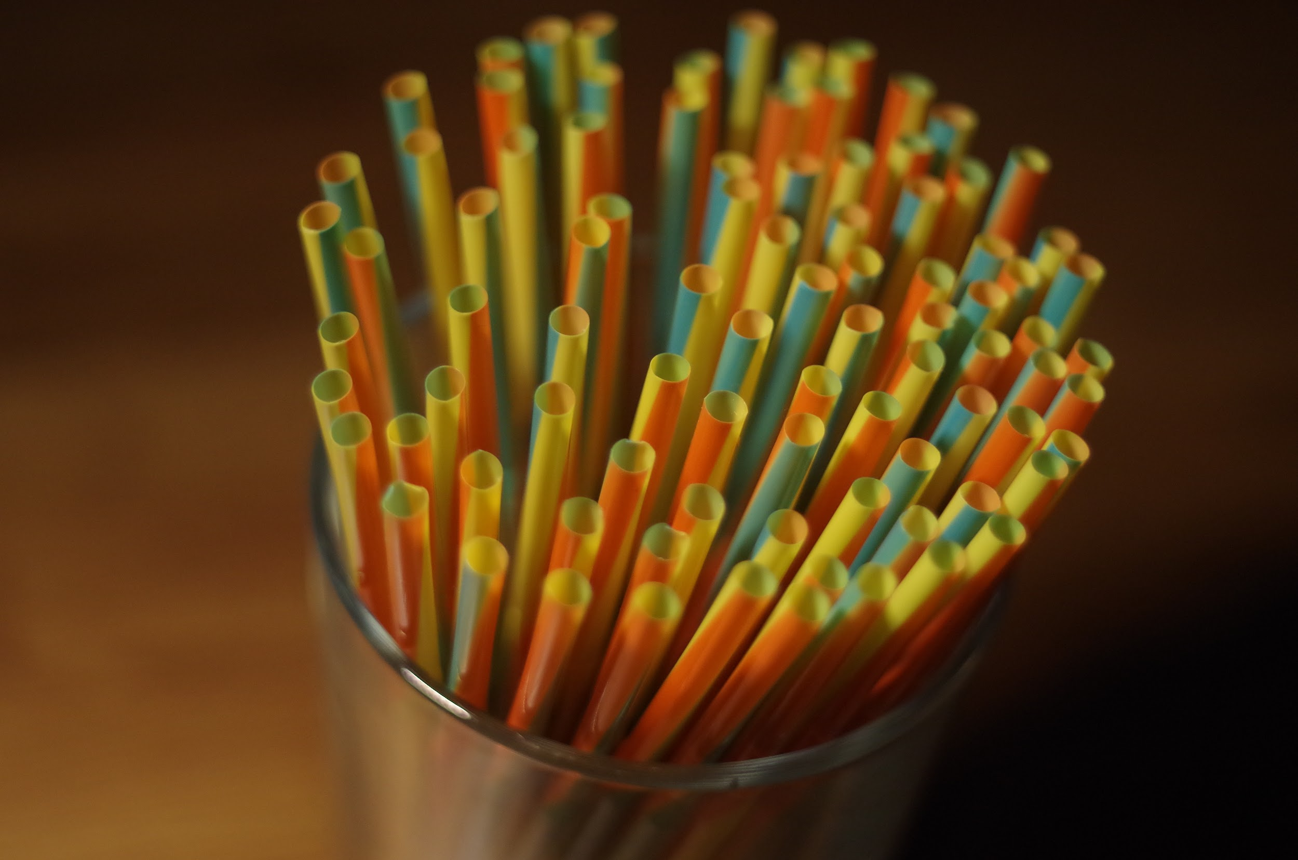
Tiny things called microplastics get in the oceans and animals eat these microplastics.
Most animals think it is food, but it can kill them or seriously affect their lives.

Slide 10
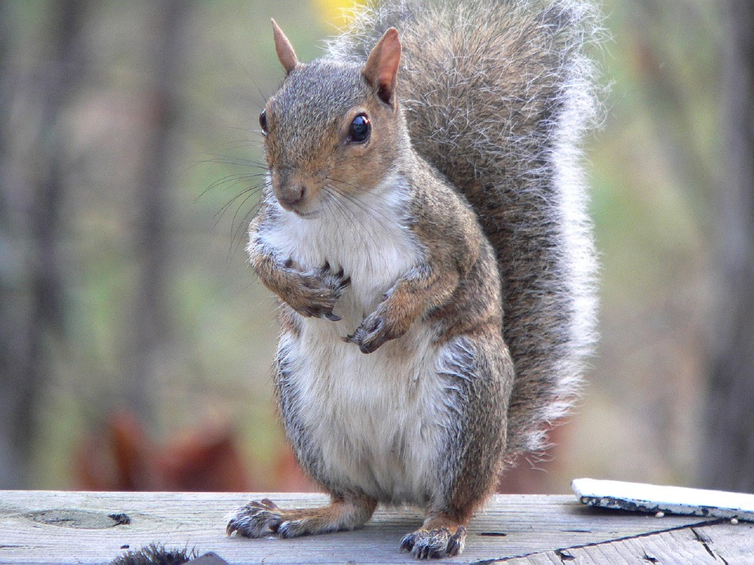
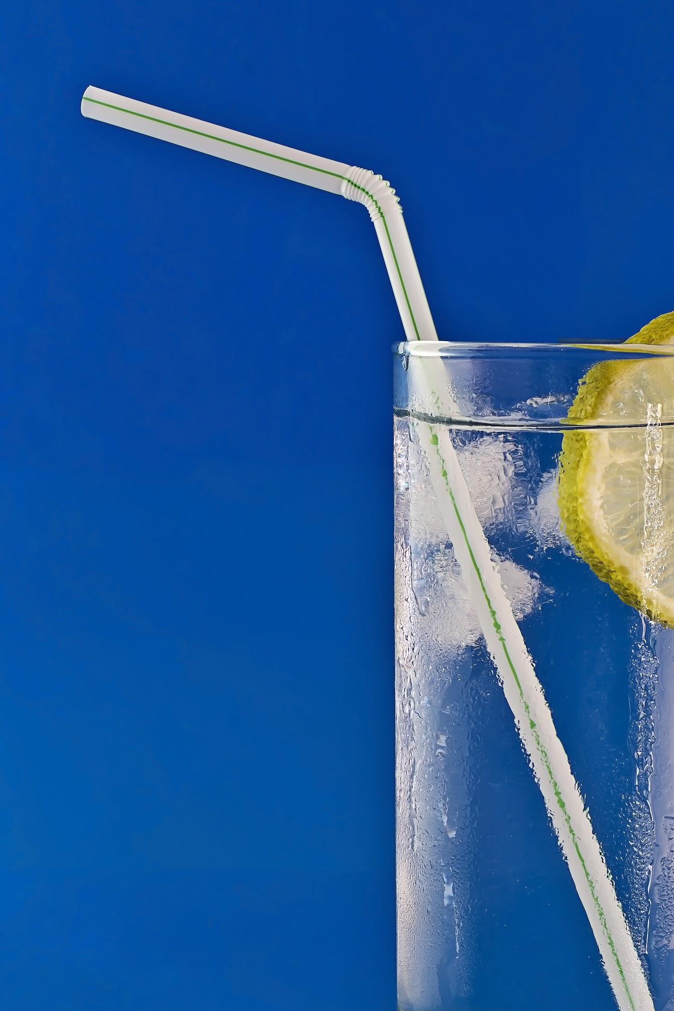

EVEN SQUIRRELS CAN STOP STRAWS!

Slide 11
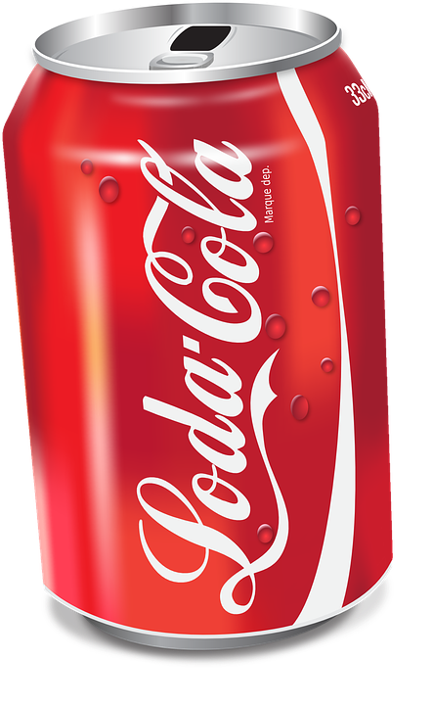


Slide 12
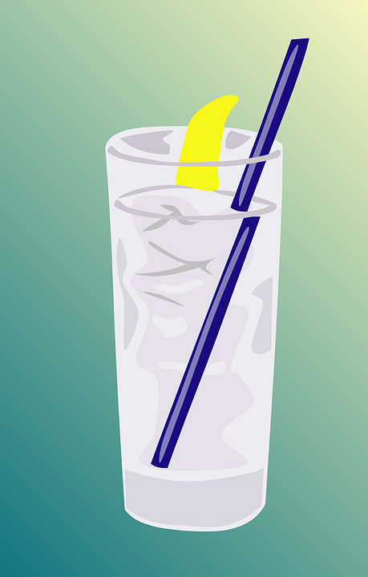
If everyone in the world uses a straw in the same day, that's over 7 billion straws!
That’s at least 1 billion straws that get in our oceans

Slide 13
You can help fight against straws.
Some things that you can do to help with the plastic straw problem include;
At a restaurant, ask the waiter not to include a straw with the drink, reducing waste.
Don’t buy/use plastic straws at home
Use reusable straws

Slide 15


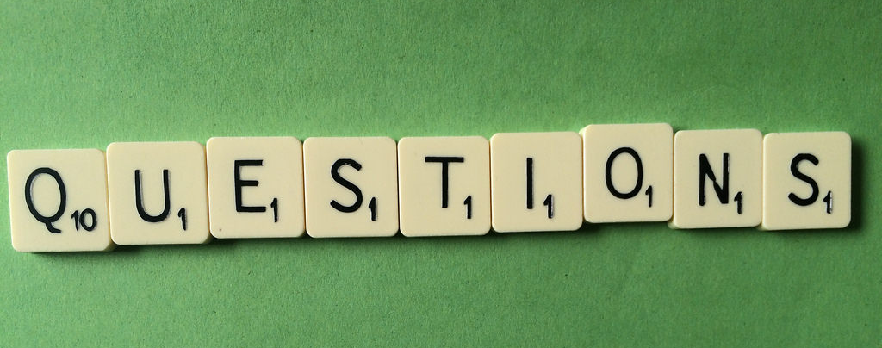
Questions?

Slide 16


