Slide 1
Say NO to plastic straws
Let’s find an alternative

Slide 2
Straws in landfill?
Did you know it takes 200 years for a plastic straw to decompose in a landfill? Plastic straws keep making their way to landfills, and then they take forever to decompose. We use them for a few minutes, and then they last hundreds of years in our earth. We can’t recycle plastic straws because they are too small to be recycled during the sorting process and the fibers are too weak to be reusable.
We can’t recycle them. We can’t throw them in the trash to be sent to the landfill. What can we do with them then?
We need to stop using and making them ALTOGETHER!

Slide 3
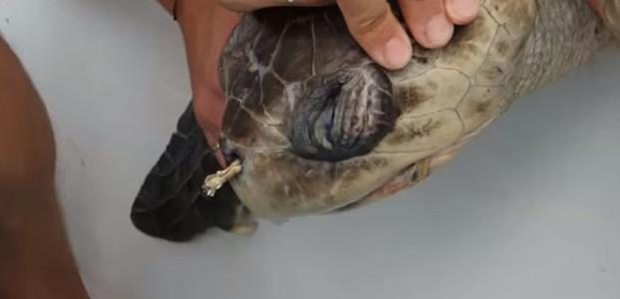
Sea vs plastic straws
Plastic straws in garbage cans or in route to landfills often get blown away and become litter. That can lead to our rivers and eventually our oceans. Plastic straws are among the top 10 types of plastic found in our oceans. Here is a shocking sea turtle tragedy.
“A scientist in Costa Rica came across an endangered species of sea turtles with what they thought was a parasitic worm blocking the turtles air way, but then the scientist realized it was a plastic straw.”

Slide 4
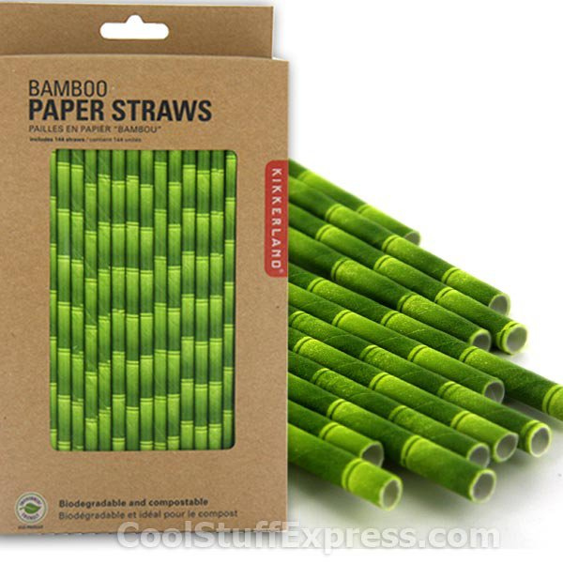
Alternative Straws
If you really like using straws, but don’t want to hurt our land and sea, here are some alternative straws: stainless steel, glass, paper, bamboo, or silicone. These are easy to take on the go and put in a purse or suitcase. There is no question that reusable or compostable paper straws are better for the environment than plastic. More than 500 million plastic straws are used every day in the U.S. These straws are typically enjoyed for minutes then they get thrown away and are too small to be recycled. We have to stop using plastic straws since they take so long to decompose and will stay in our environment for future generations!

Slide 5
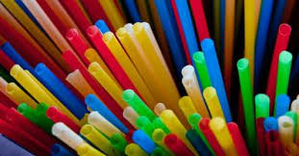
You Can Save The Earth by Not Using Plastic straws
Anywhere you are you can save life on Earth by not using plastic straws. Plastic straws kill over
100,000 sea animals annually US alone!

Slide 6
What can the Government Do to help?
We personally think that the Austin City Government should BAN PLASTIC STRAWS! This is the best case scenario because it will force businesses to comply and people to learn about the issue and act accordingly to help the environment.
However, if you can’t ban plastic straws just yet, you could give a TAX BREAK for any businesses who don’t buy or distribute plastic straws. You could also give tax breaks for those who use alternatives. You could even tax businesses who make or buy plastic straws have a higher tax on plastic straws (like what the government did with cigarettes.)

