Slide 1
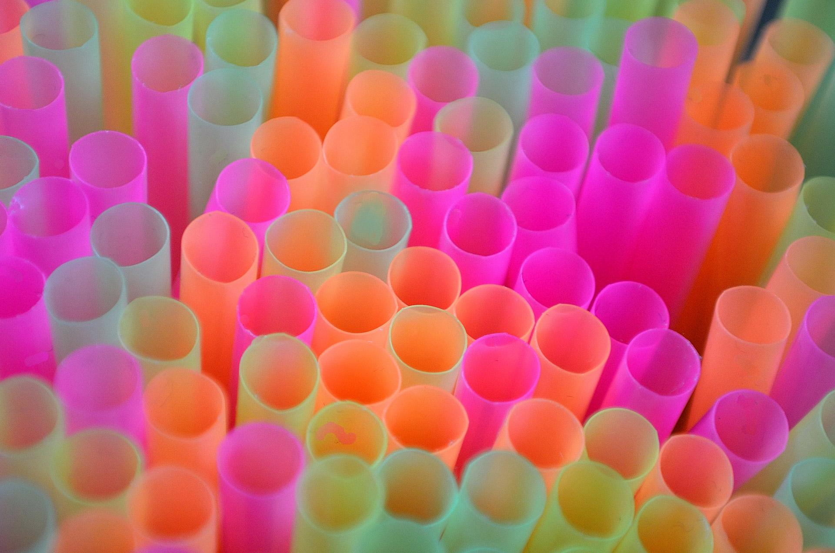
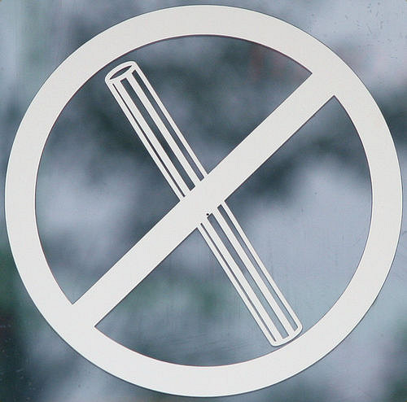
New Laws For Straws
By: Izzy, Zayden, Colt, and Charlie!

Slide 2
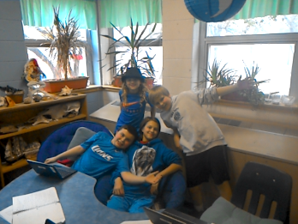
Who are we?
We are 5th graders who go to Hill Elementary School. Our awesome Science teacher, Mrs. Cotten, told us about plastic straws and what they are doing to our environment and now we want to help solve this problem!
We want to share with you WHY plastic straws are bad and HOW we you can help.

Slide 3
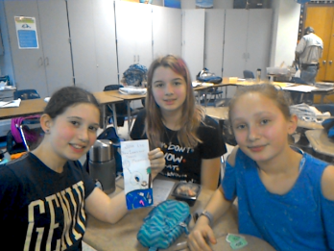
Brochure Ladies
These are the creators of the brochure we passed out to you. The brochures include more facts and details that can help you understand the problem in more detail.

Slide 4
What is our campaign about?
We have all, most likely, used plastic straws before. You might think they can’t be that bad. Well you’re wrong. They are horrible because they are hurting our planet!
So what is our goal? We want to stop the usage of plastic straws. Would you join us and stop using plastic straws and try some alternative solutions?

Slide 5
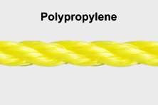
What are Plastic straws made of?
Historically, straws have been made from paper but today polypropylene plastic is the material use most. Polypropylene is a resin made by stringing together molecules of a propylene gas. This means that plastic straws take a very long time to decompose.
Notes:
http://www.madehow.com/Volume-4/Drinking-Straw.html

Slide 6
Why are plastic straws bad?
LAND
Plastic Straws HURT LAND: Plastic straws take 200 years decompose. When they make it to landfills, they take so long to decompose, that they take up space in landfills and stay there for a long time. Also, if an animal eats plastic straws, even when the animal dies, the plastic still stays on the earth for more than 200 years! Crazy, right?

Slide 7
Why Are Plastic Straws Bad?
AIR
When straws are made, we use fossil fuels to make them. When we burn fossil fuels, this releases CO2 in the air which contributes to climate change. Also, when plastic straws finally do decompose, they will release methane, another greenhouse gas, which will further warm our planet. Plastic straws also have BPA in them, which may be harmful for humans.
Notes:
,

Slide 8
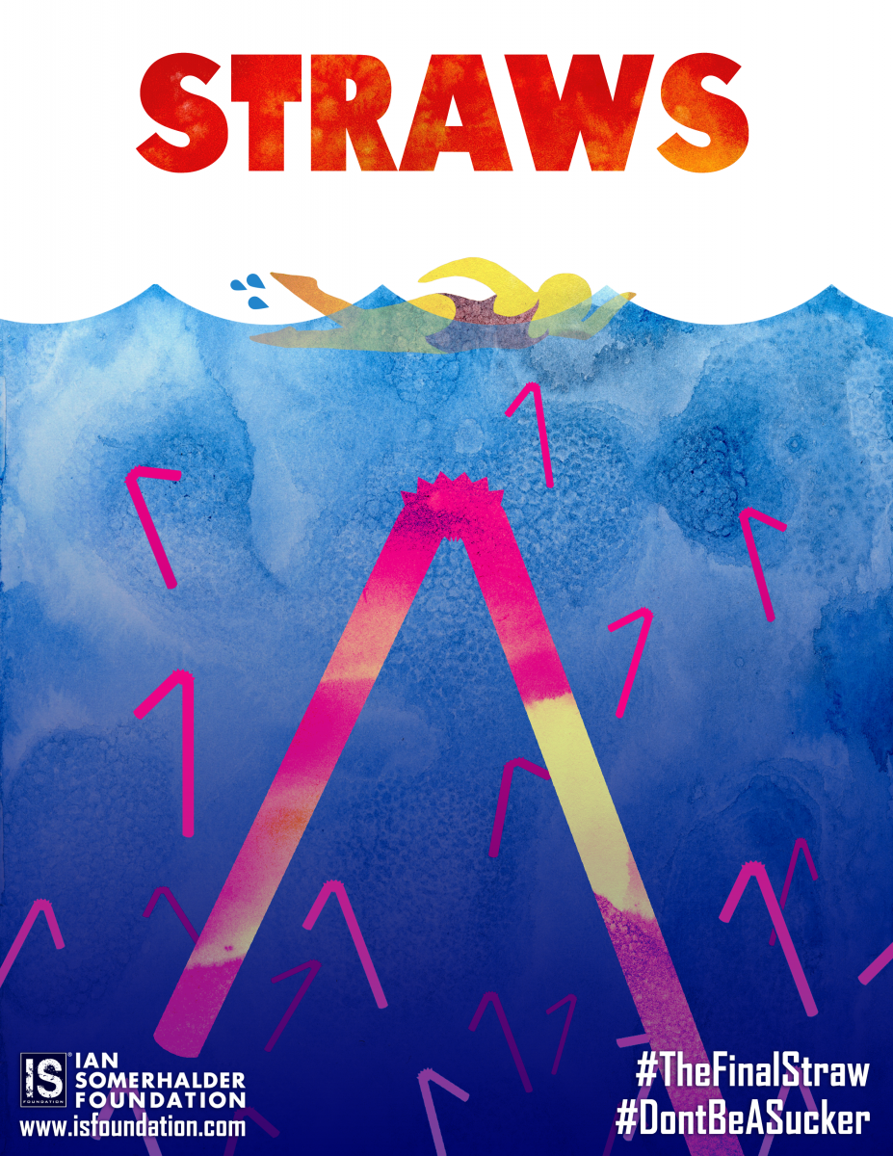
Why Are Plastic Straws Bad?
SEA
Plastic Straws HURT ANIMALS: About 100,000 animals die from plastic!
Plastic straws can hurt sea life pretty badly. For one thing, animals in the ocean often mistake plastic straws as food and then eat them! Then they have bellies full of plastic. This will either kill them, or just stay there, not decompose, and then we may even eat them, and that could make us sick!
Secondly, they can get straws stuck in their airways, like their noses.
So plastic affects every living thing, human or not, so put yourself in the animals’ flippers.
Notes:
,

Slide 9
Alternatives to Plastic Straws
Now I know some of are thinking “what about people who need to use straws, like people who don’t have use of their arms, or can’t sit up?”
Well, let’s talk alternatives: Other materials use to make straws are paper, bamboo, and metal. There is a great paper straw distributor called Aardvark Straws that distributes eco-friendly paper straws. You can also choose to make your own homemade straws. Here is a recipe for paper straws:
http://www.natashalh.com/how-to-make-your-own-custom-paper-straws-great-for-diy-weddings-and-holidays/

Slide 10
SAY NO TO PLASTIC STRAWS:
Solution Ideas
Austin City Government Bans Plastic Straws
Businesses don’t serve plastic straws at ALL (saves businesses money and the environment)
Businesses only serve plastic straws if a customer asks (Maybe server tells customer they have to ask, or write on menus that if a customer wants a straw they will have to ask for it)
People stop using plastic straws and inform their servers right away that they don’t want any straws. (hard to remember)
People and businesses use and buy alternative plastic straws

Slide 11
Children Helping
https://www.youtube.com/watch?v=Rr5Py1r9xjw&t=157s
http://video.nationalgeographic.com/video/short-film-showcase/wishing-for-healthy-oceans-these-kids-take-action-against-plastic
https://www.youtube.com/watch?v=QSCbpcpjJl4

Slide 12


Special Thanks
Mrs.Cotten
Maya Fuller
Mia Stern
Lauren Hanley
And Last But Not Least
Alamo Drafthouse

Slide 13
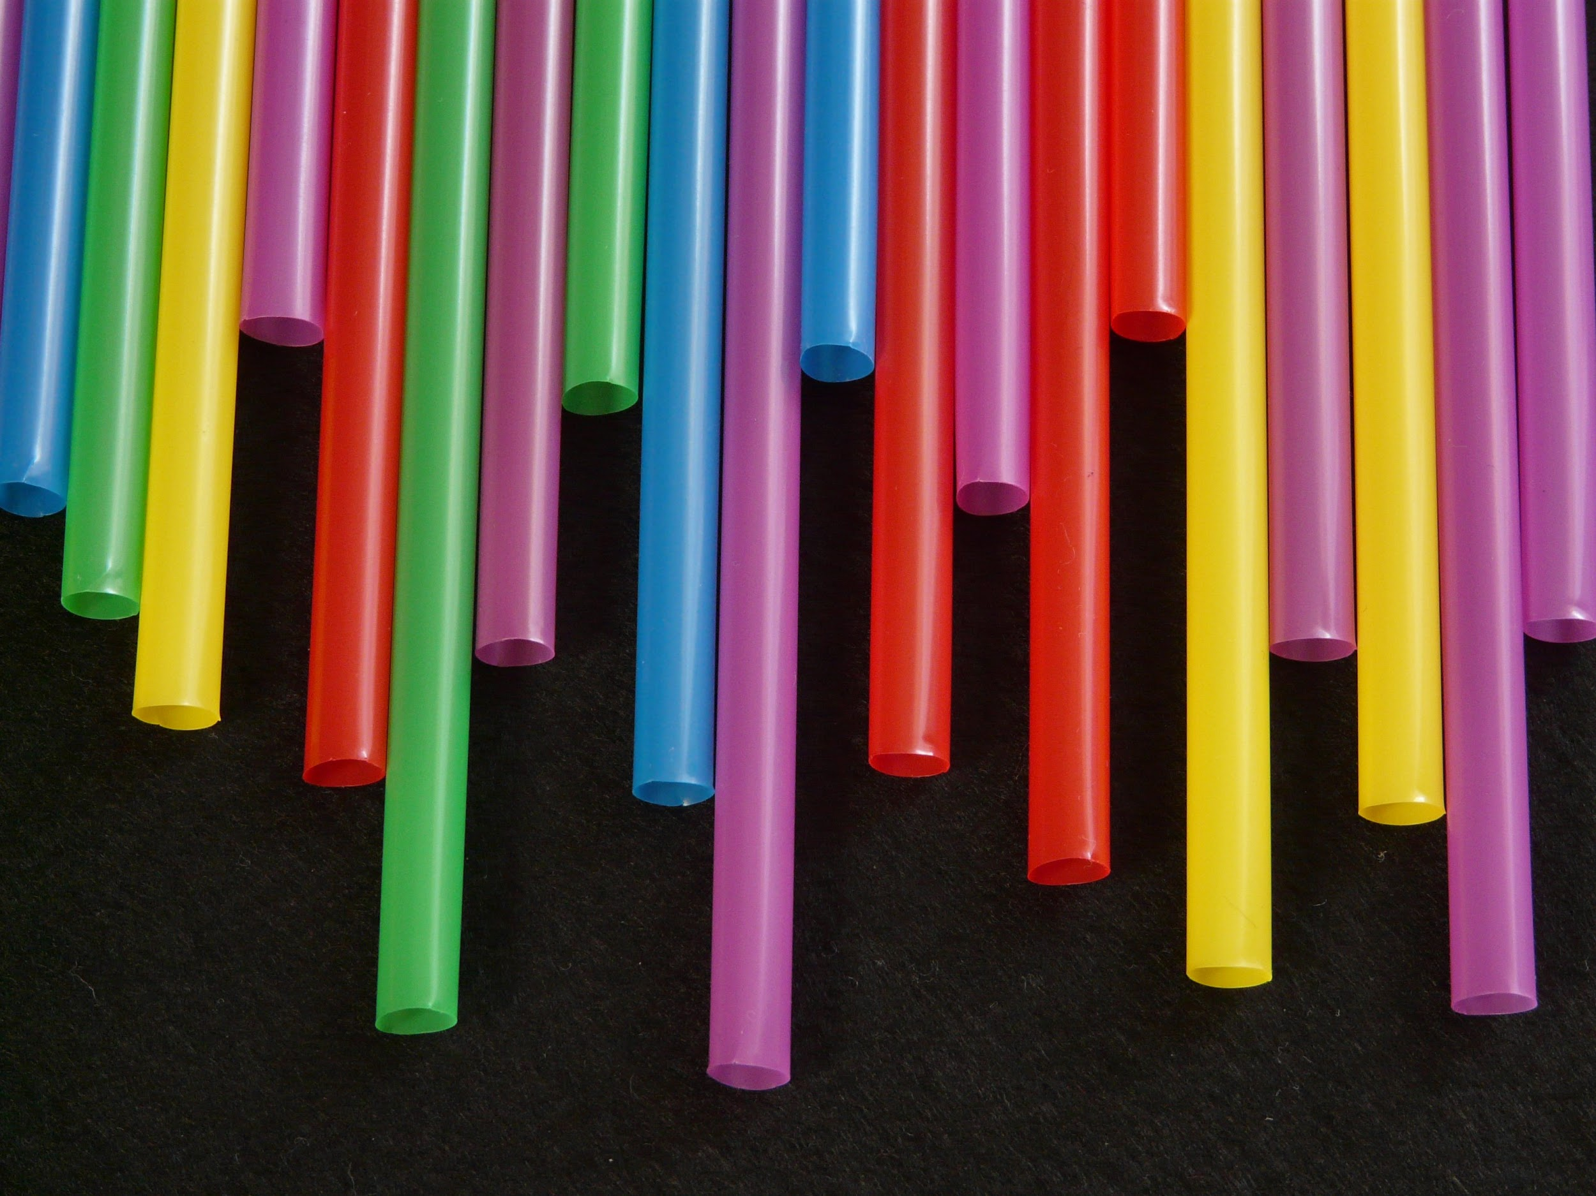
Thankyou!
For listening!

