Slide 1
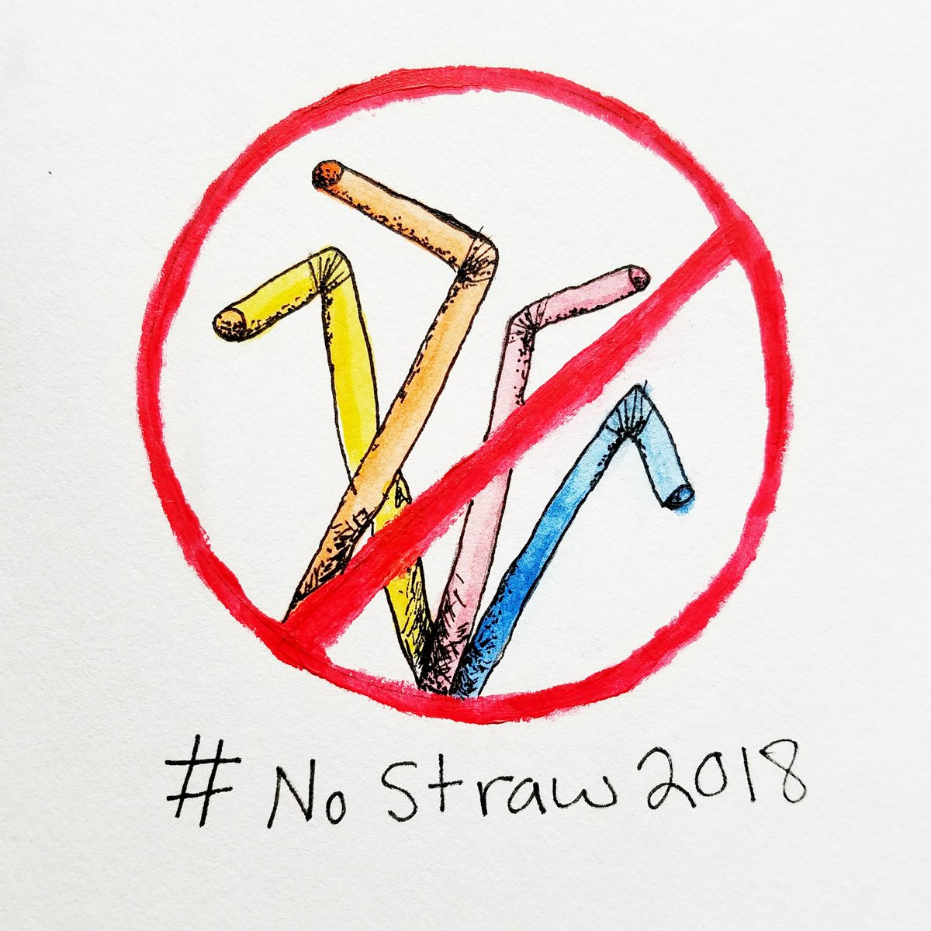
No more straws!!!!!!!
By: Julieta, Indy, Luke R, Ava, & Hannah

Slide 2
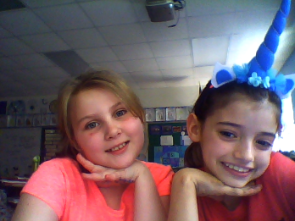
Who are these beautiful scientists and activists?
This is Julieta and Hannah. We are the creators of this slideshow and some brochures we are going to hand out at the end of this presentation. Hannah and I are ready to present but first we will introduce you to...

Slide 3
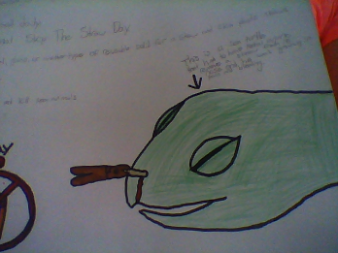
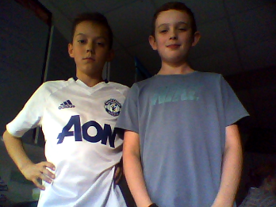
The poster dudes!
Indy and Luke worked so hard on their posters and we have to thank them for their help.

Slide 4

Why Should We Care?
Do you guys like sea turtles? Do you guys like plastic straws?
Fact: 30% of sea turtles are found dead with plastic in their stomachs. Did you now that 100,000 marine animals are killed ANNUALLY?
It's ok to use straws but NOT plastic straws becuase they are hurting our environment. There are so many alternatives out there.
SAY NO TO PLASTIC STRAWS!!

Slide 5
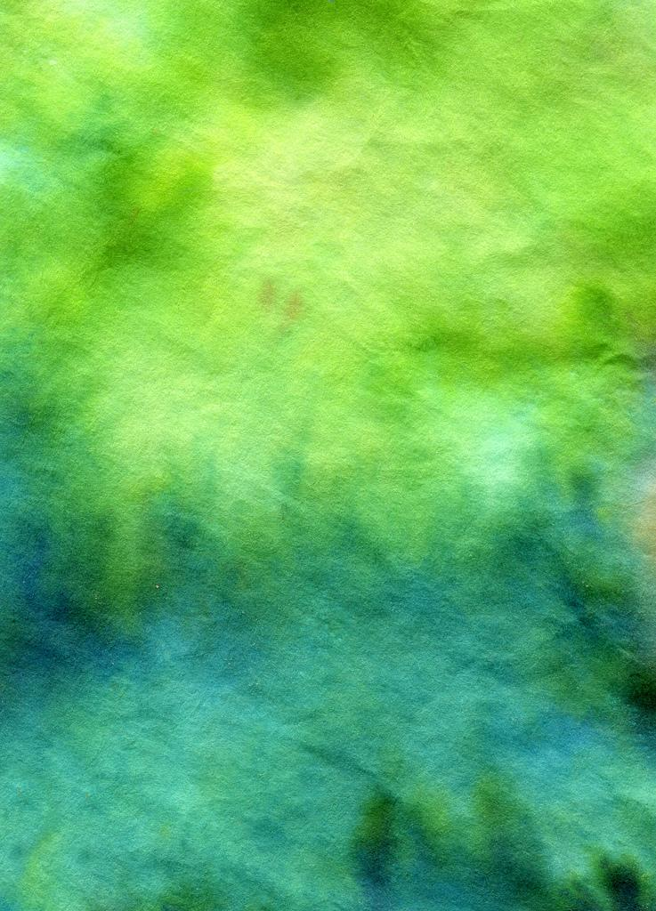
Alternatives
Of course we should try to cut out straws all together but we may need to take baby steps.
First let's start with alternatives. Here are a couple of alternatives if you really need to still use straws: metal, bamboo, and paper.

Slide 6

Points and numbers
Let's take a look at percentages to understand the problem a little better:
500 billion plastic straws are used DAILY! That's enough to fill up 125 school buses!!! Or to go around earth 2.5 times!!!!
The only way you can help is to say NO to plastic straws when you go to a fast food restaurant or the movie theaters etc. So lets say NO TO PLASTIC STRAWS!!!!

Slide 7

What you can do to help!
When you first sit down at a restaurant or business that serves drinks, make sure you inform your waiter that you DO NOT want a plastic straw. Many times, servers, waiters, business owners, will automatically put a straw in your drink and give it to you, without asking. So you have to let them know before you even get your drink. Otherwise, even if you didn’t want a straw, you may end up with one!
Let everyone you know about this and encourage them to do the same!

Slide 8
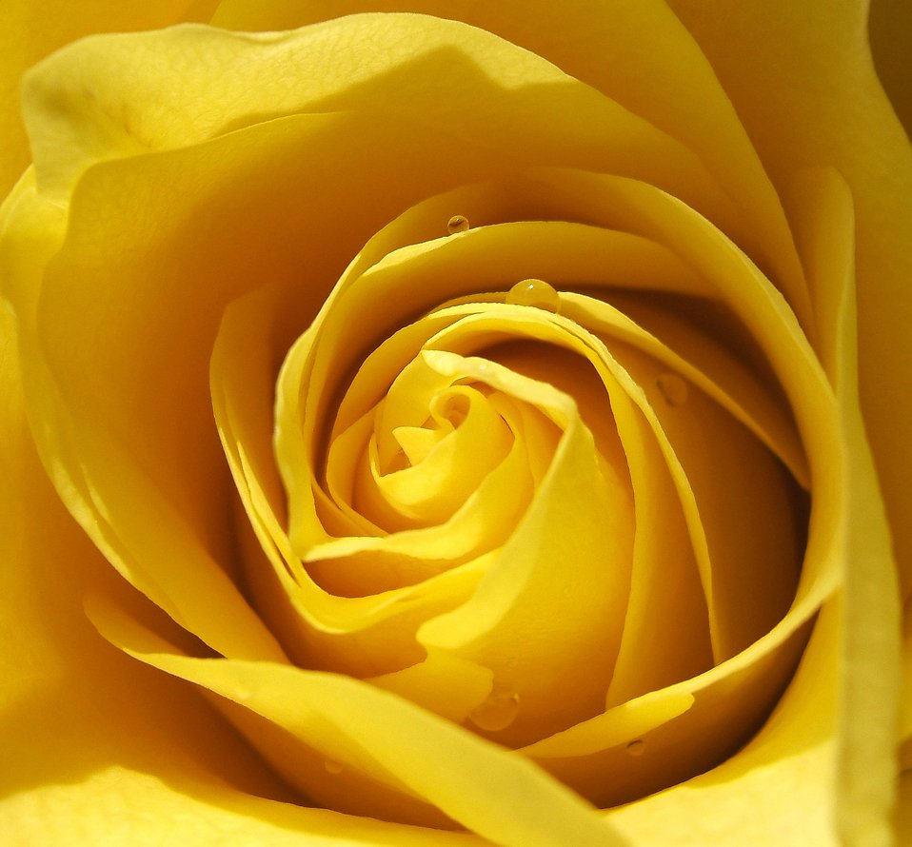
HOPE YOU ENJOYED!
BY:Julieta,Indy,Luke R,Ava AND HANNAH

Slide 9
Thank you to
Luke R - For his poster with the amazing facts
Indy - For his amazing work on the poster
Mrs Cotten -for making this whole thing possible

