Slide 1
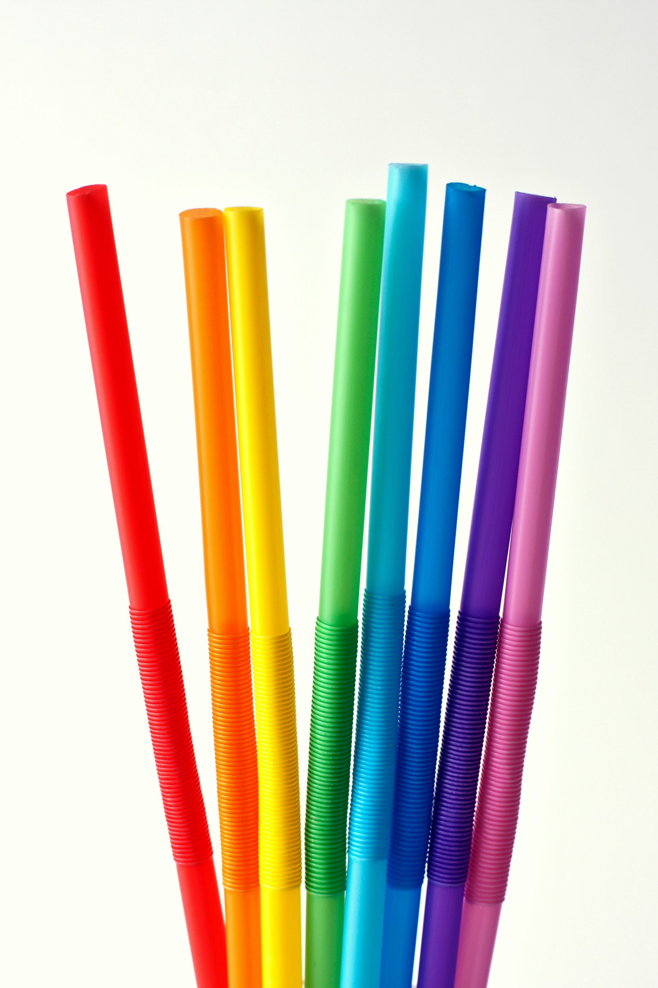
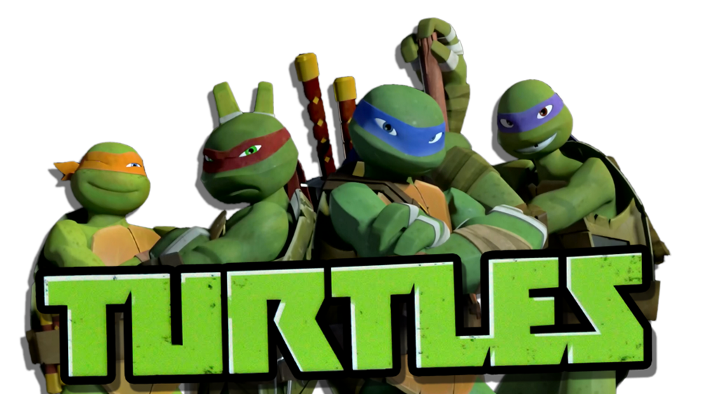
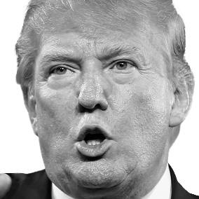
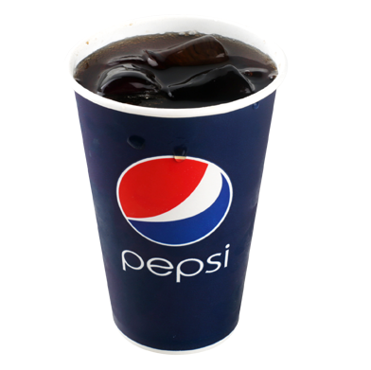
STOP THE STRAWS
Its good for yur health

Slide 2
Get your last straws now!
:>)

Slide 3

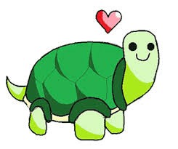
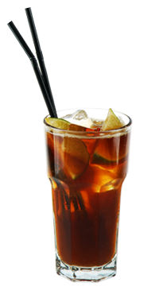
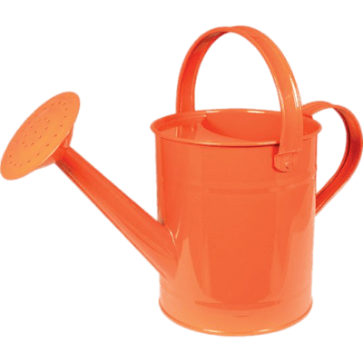
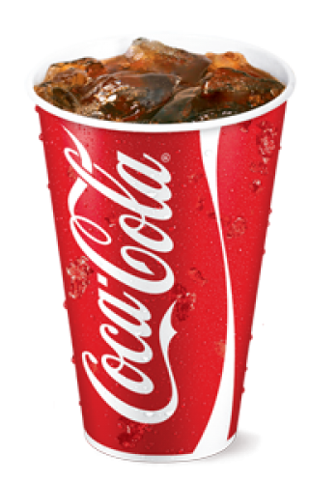

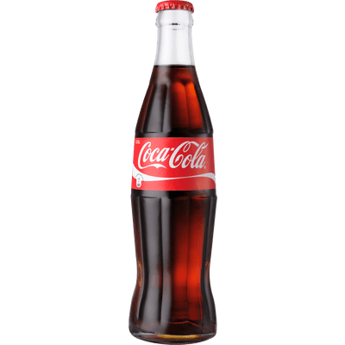
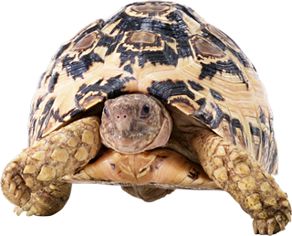
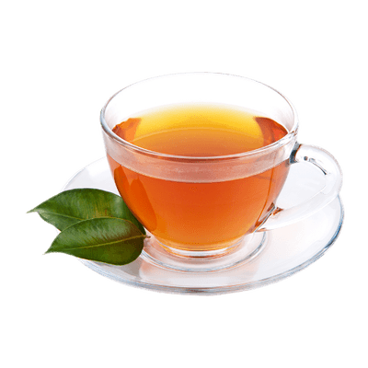
see this turtle is will be dead bc of FRIGGIN STAWWWSS ITS ALL yoh HUMANS FAULT so ask your human ARE HORRIER BAWHRCUttfg\TAGTRGThbhhhgheHJkJE YOU HORRIABLE TO THE FAMILY UGH THIS IS MY TURTLE GET ON MY LEVEL SAVE THEM ALLL
Notes:
Jake is da best #jakepaulers

Slide 4
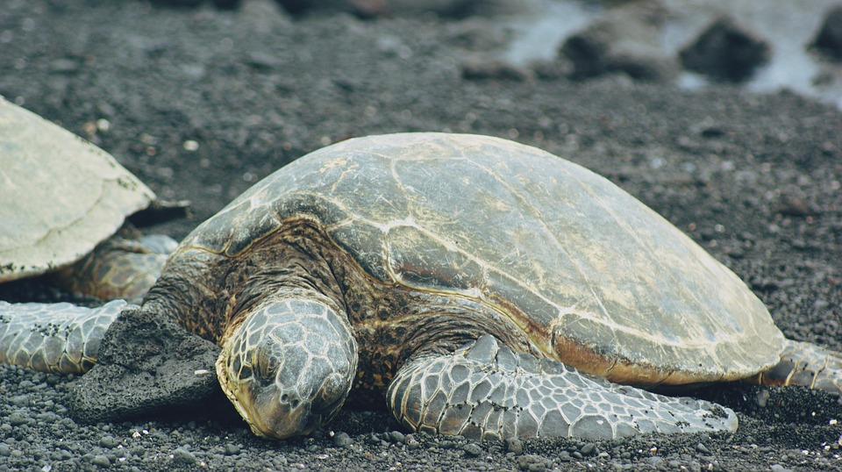
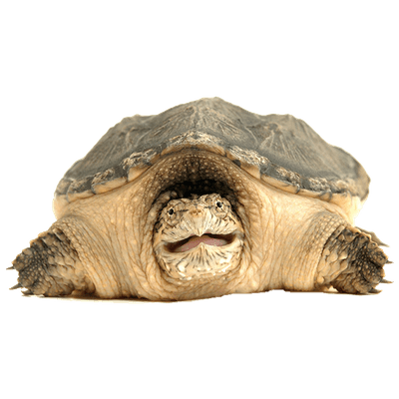
Facts :D
Did you know that 70% of Birds and 30% of turtles get Severely hurt of plastic realataedaded things?
Many people use straws they sometimes end up in bad places there not supposed to be in like the ocean that’s a horrible place sharks will eat you kids (its safe they will not)
-ok so try using less straws bc *shrug* well it will kill your animal friends! No really it’s just that everyday 500 straws are uses per day! Im telling yah
YOU FRIGGEN FAILURES WITH MY TRUTLES FRIGGEN HORRIABLE PEOPLE

Slide 5
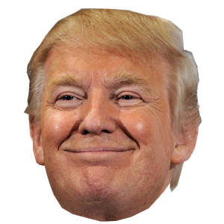
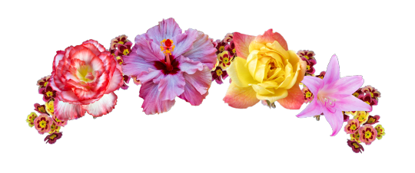
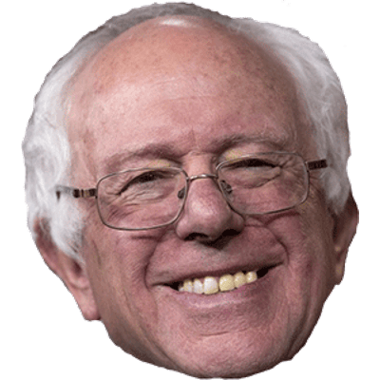
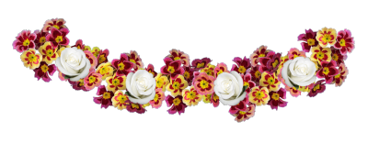
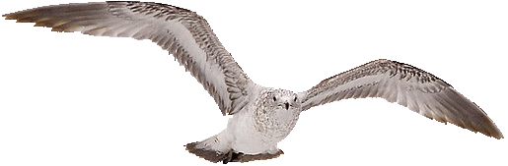
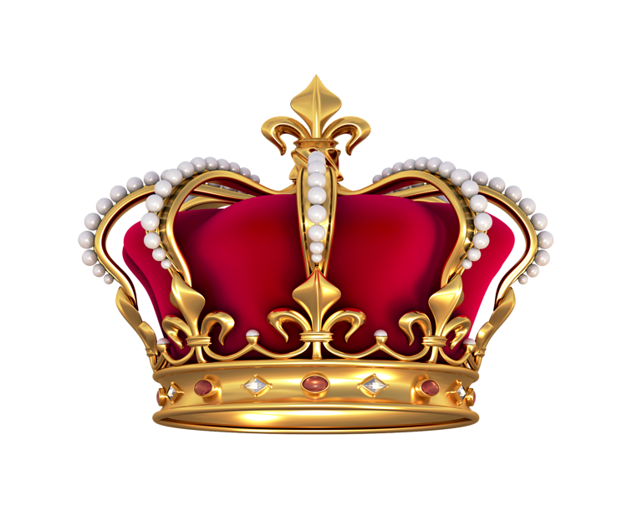


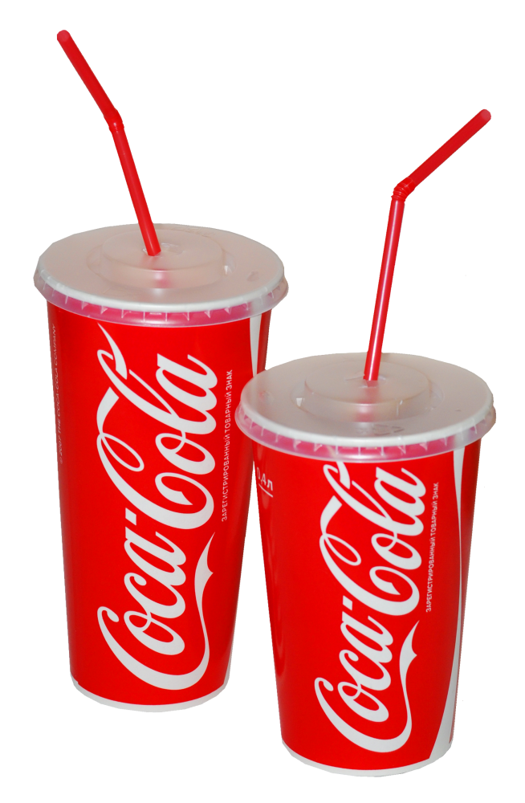
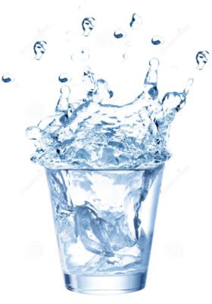
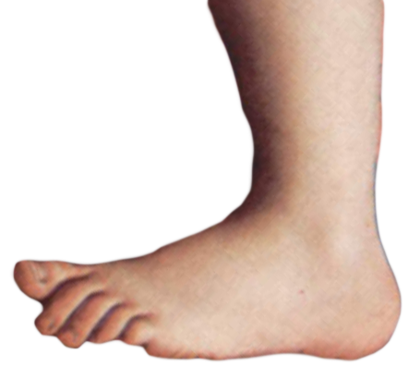
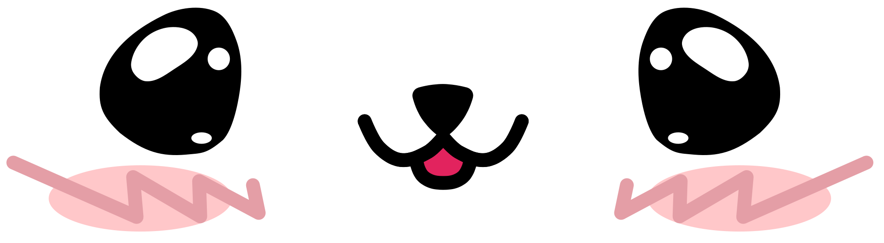
Take it serious, this is the real world with real people and real animals die every day it’s our fault look how serious we are!
2018 vote mr coke!

Slide 6
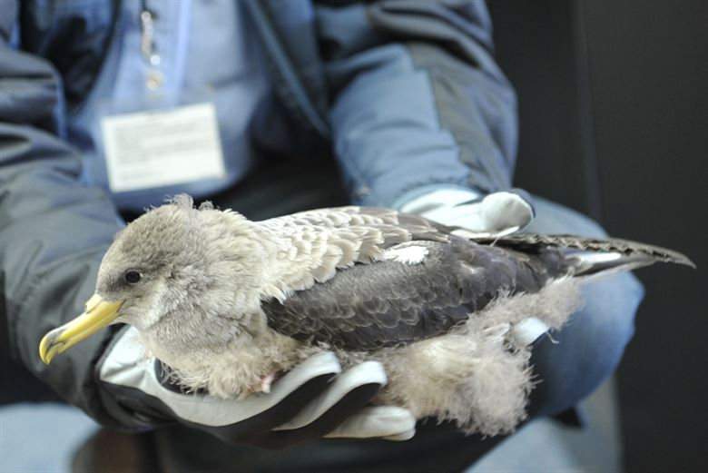

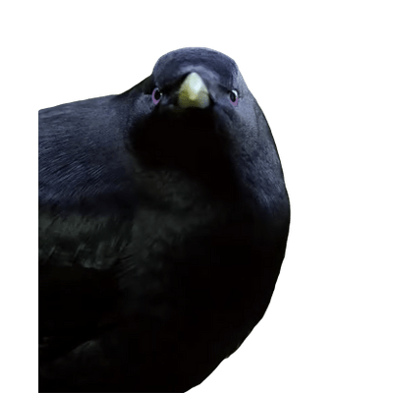
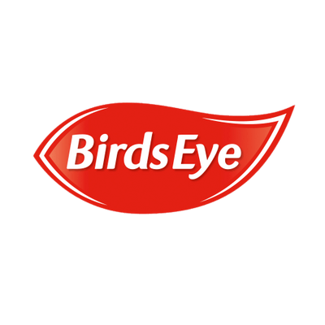
Birds and turtles are in danger!
Both birds and turtles are in danger because of these straws! Save the turtles and birds! Stop using plastic straws. If you love any sea animal and don’t want to Sea (clark the pun god)them go endangered stop using these straws

Slide 7
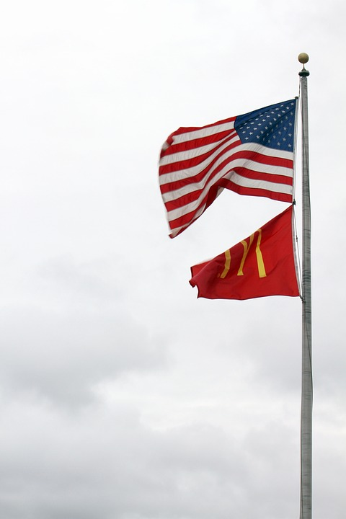
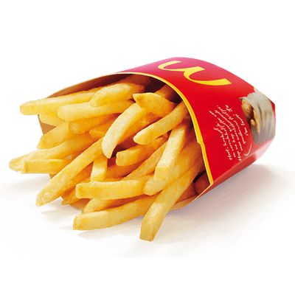
How to change this problem!
Well you can start by
Not using plastic straws
Use more Harder things as a straw like Steel,Bamboo,Glass(YO MOUTH DIES)
Do an Ochen clean up
Help convnce people not to use them that much
Only use them When HAVE TO
(pretend the fries are straws :>} )

Slide 8
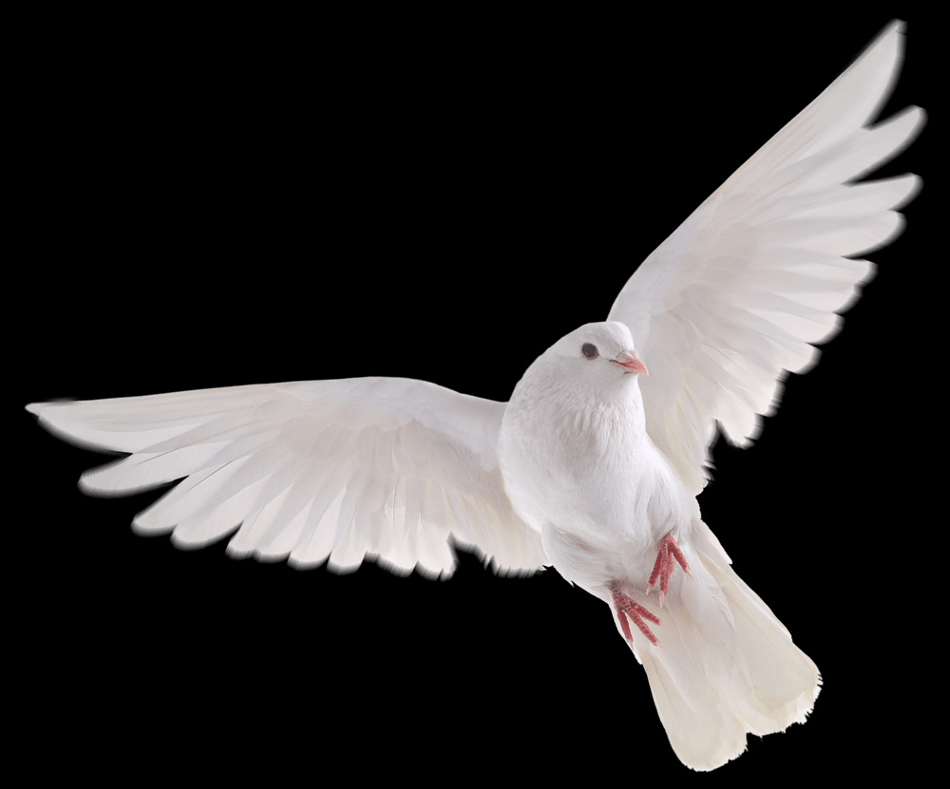


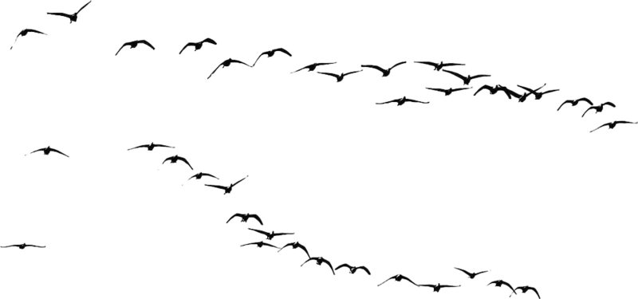



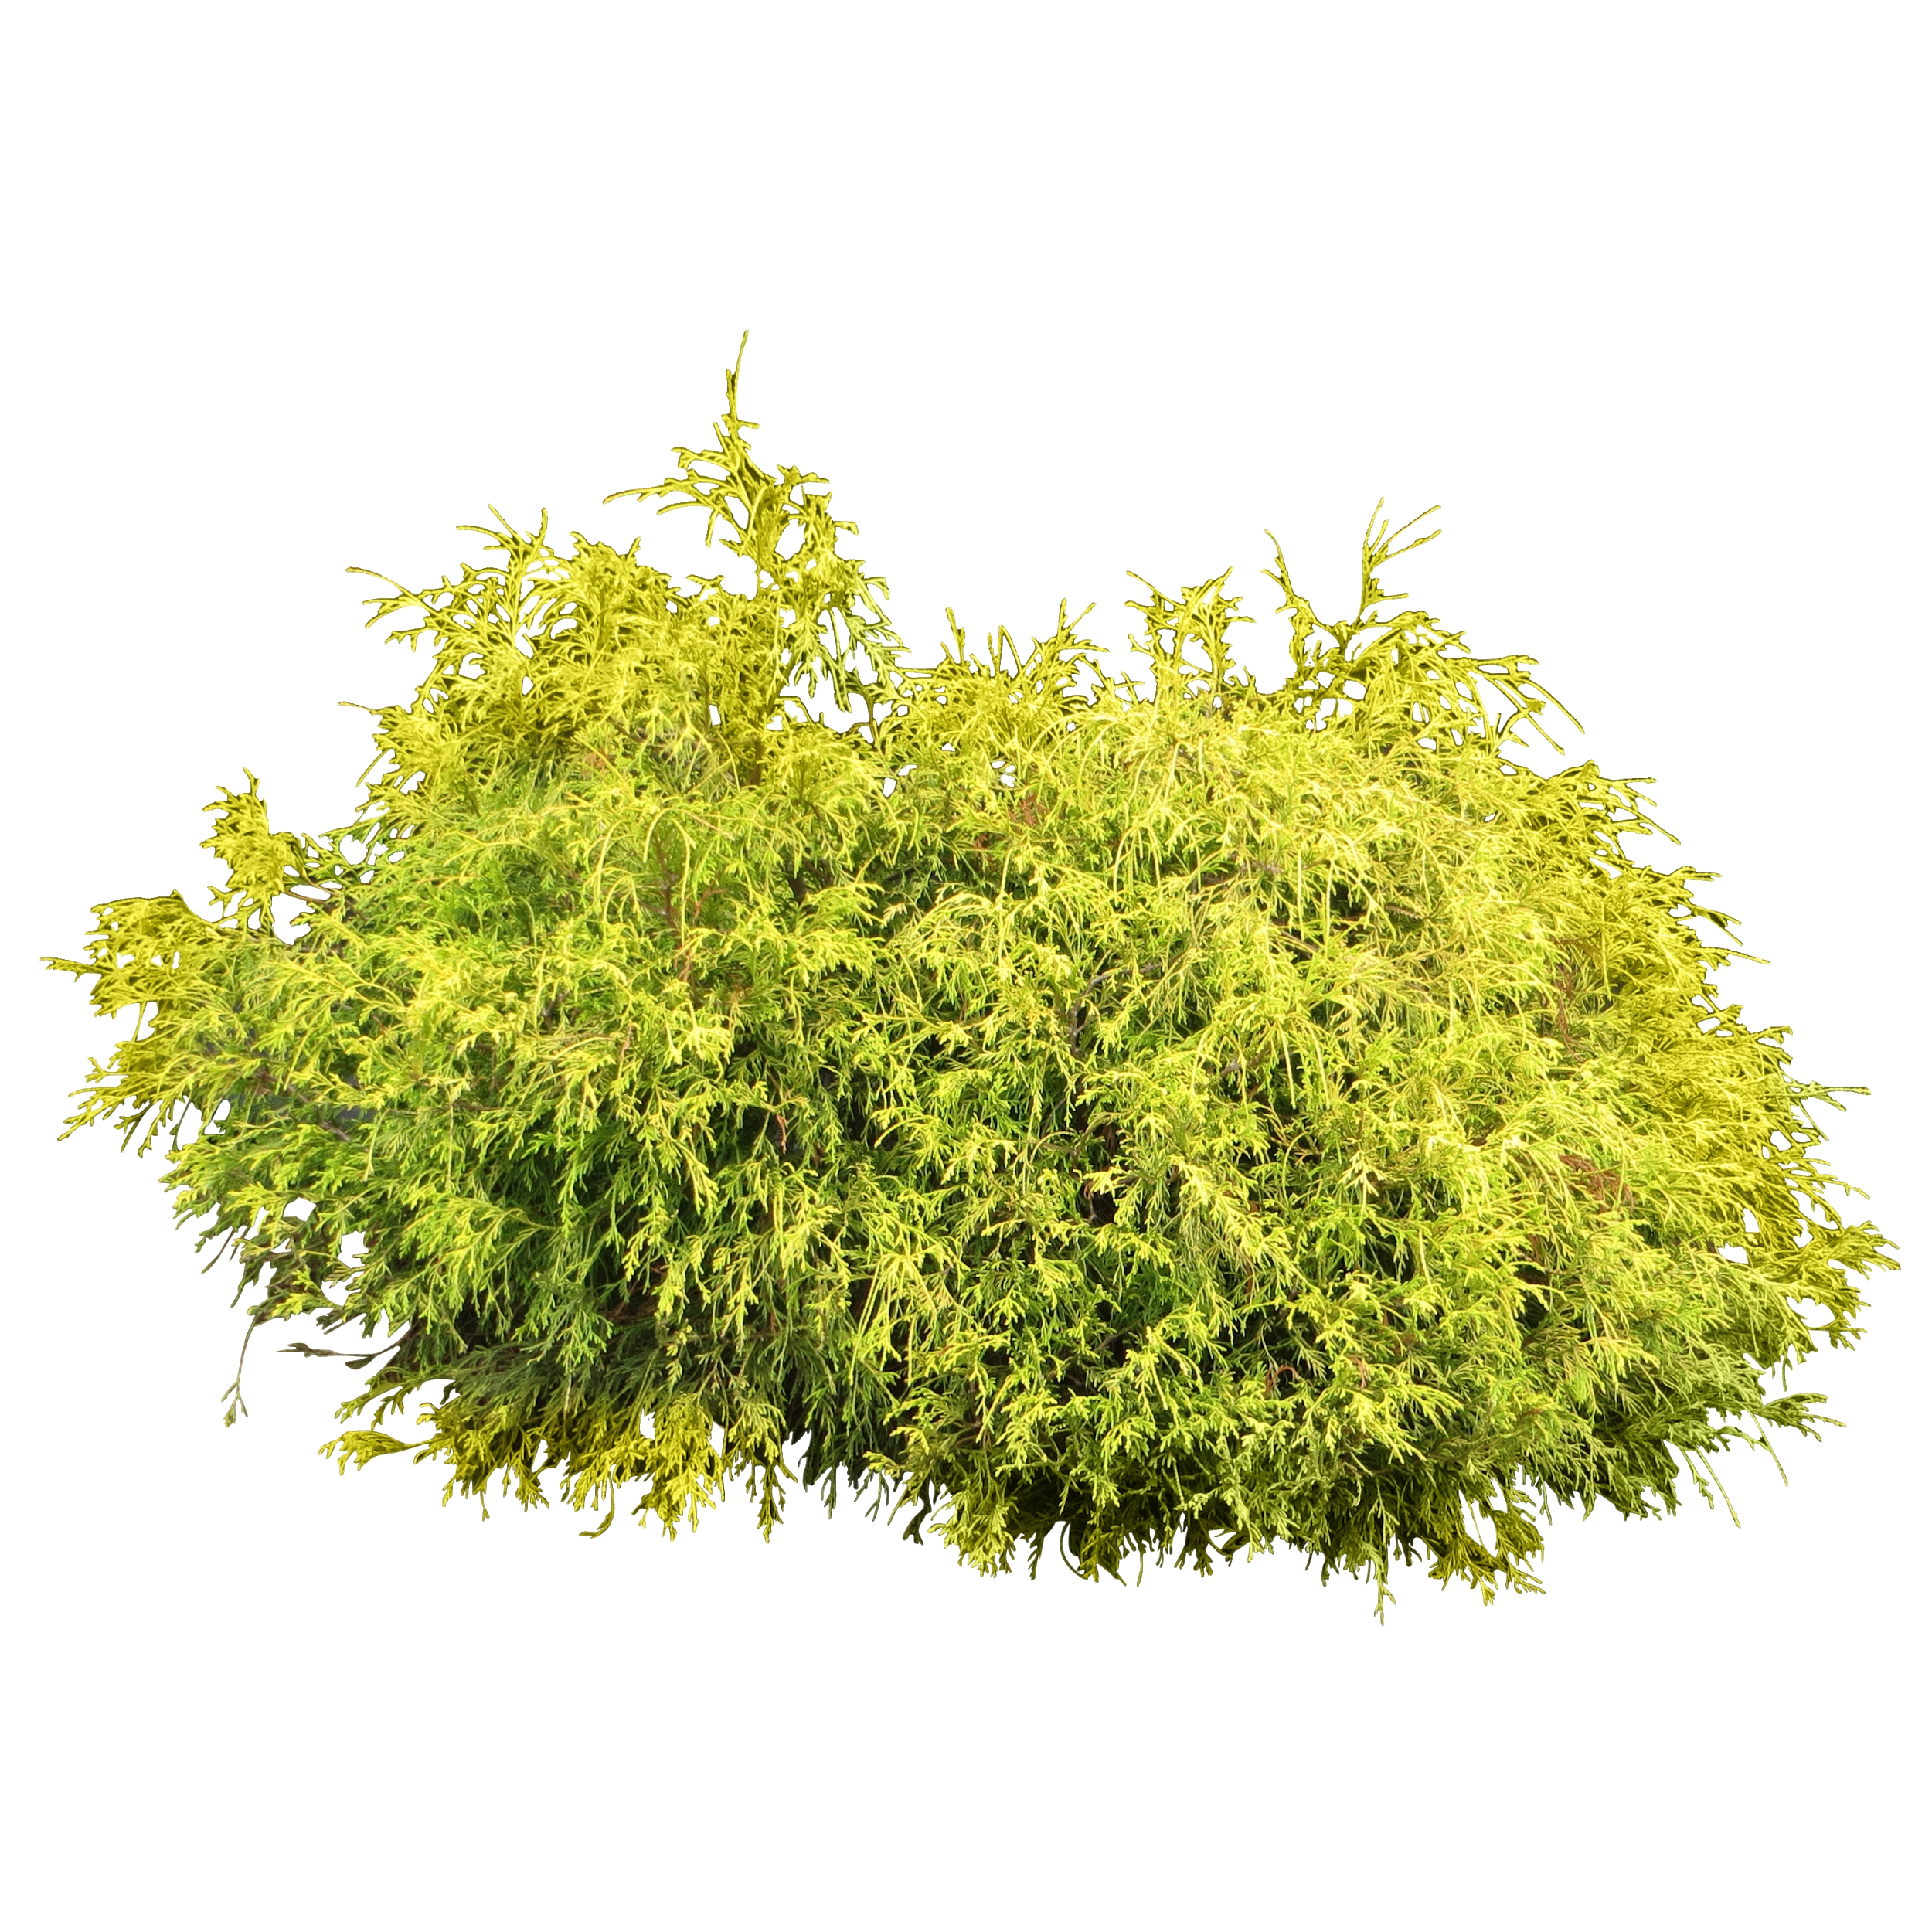
PEACEEEEEEEEEEEEEEEEEEEEEEEEEEEEEEEEEE
About 5000 million straws are used for day we should jsut so if we are peacefull and nice and happy to straws and make them outa BAMBOO aand things :DDD UNLESS YOU HURT MY FRIGGEN TURTLELHFYWGGHJHJAHJNHJGFHWGHWGJAKAHKHGHJGJH

